Slide 1


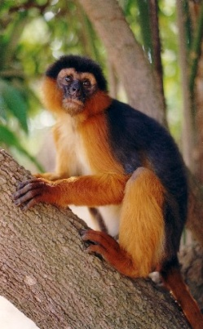
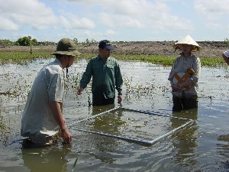
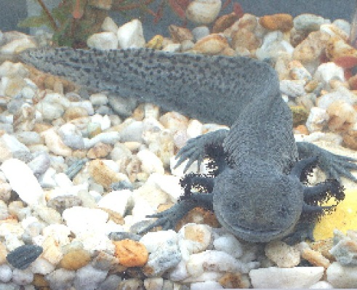
The Darwin Initiative
Project Logic, Indicators & ToC
Group Exercise

Slide 2
1. Project Logic ‘puzzle’
Place (and when agreed stick) the logframe elements in the correct ‘boxes’. Fill the boxes in numerical order:
 | Project Logic | Measurable Indicators | Sources /means of verification | Assumptions
Impact | 1
Outcome | 2 | 7 v | 8 vii | 6 ii
Outputs | 3 ii | 9 vii | 10 xi | 5 ii
Activities | 4 xi

Slide 3
2. Assess SMARTness of the Indicators
Agree on a score ‘out of 10’ for each of the Indicators in the logframe, using a score out of a maximum of 2 for each of the S, M, A, A, R and T elements, e.g.
S 1
M 2
A 0
R 2
T 1
Total score 6 (out of a possible 10)

Slide 4
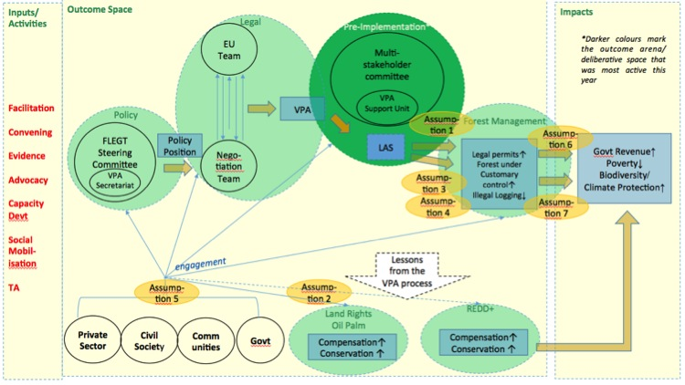
3.Theory of Change Diagram
If time permits, roughly draft a ToC diagram for the project described in the logframe, e.g.

