Slide 1



Theory of Change
Articulating your project’s design theory

Slide 2
Design Theory?
What is it that you are trying to do?
How will it deliver a change in something and what are your assumptions?
What are the conditions that need to be in place for that change to happen?
How will the change in something address the problems that you have identified?

Slide 3
The results chain
Inputs
Activities/
Process
Outputs
Outcome
Impact
Management control diminishes
Internal perspective (M)
External perspective (E)
Results
Physical & financial
resources
Processes which turn Inputs into Outputs
Operational changes (new skills or abilities, the availability of new products and services).
Behavioural or institutional/
changes in response to the outputs
Progress towards
thematic priorities
External factors become more important
Notes:
This is a very important slide and adequate time should be allowed for discussion.
Note the slide presentation is in three parts which correspond to important learning points.
Firstly, the core sequence of Inputs to impact.
Secondly, the internal/external perspective
Thirdly the matching but opposite environmental issues that management control diminishes and external factors become more important as the chain progresses further from inputs to impact.
Core sequence
Show the core sequence and talk through the description of each stage from inputs to impact.
The terms are in wide use in international and national public sector processes and there is wide agreement about their use.
Internal/External
The sequence has two parts to it: those items under the control of management and those that are more dependent on external factors.
The use of inputs, management of activities and delivery of outputs are under management’s direct control. Management of output delivery is handled by processes that are within the organisation.
The success of timely and accurate delivery of outputs is something that managers can be held directly accountable for.
As such, this part of the results chain is considered to be ‘Internal’ to the process and comprises the internal perspective.
Show the Internal Perspective – External Perspective part of the slide
The achievement of outcomes, however, depends on how the people or institutions which are the focus of the activities react to the outputs that are delivered.
Management of progress towards outcomes and impact requires interaction with stakeholders and an understanding of their views about the outputs. That is why it is considered to be an external perspective.
This is not under the direct control of management, but, given that the reaction will depend on the quality and appropriateness of the outputs, it is said that managers can be held accountable for managing towards outcomes.
Impact is a long-term aim. Impact will usually depend not on a single project or set of activities, but on many complementary interventions. Managers cannot be held accountable for impact.
The step from the internal perspective to the external is often referred to as the ‘missing middle’ as it is not explicitly expressed in tools such as the logframe, yet it is the most important step in the results chain where people’s behaviour changes in response to outputs and thereby leads to progress towards outcomes.
Management control versus external factors
Show the third and last part of the slide
These diagrams illustrate the internal/external dimensions. As management control diminishes so the influence of factors that are external and outside management control become more important.
The risks of not achieving outcomes increase and those risks need to be taken into account during the planning process.

Slide 4
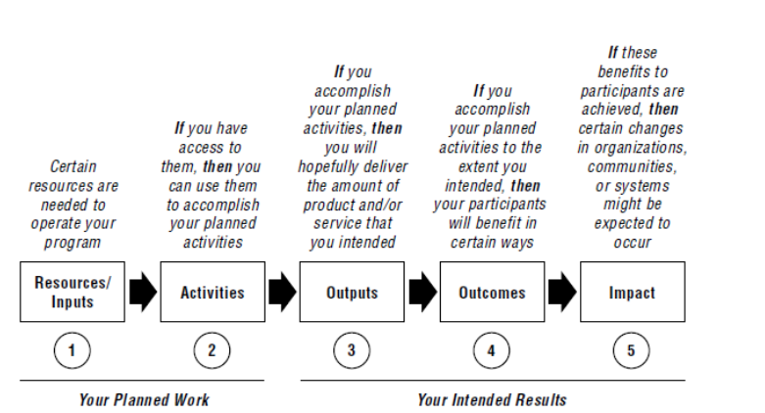
Programme Logical Hierarchy

Slide 5
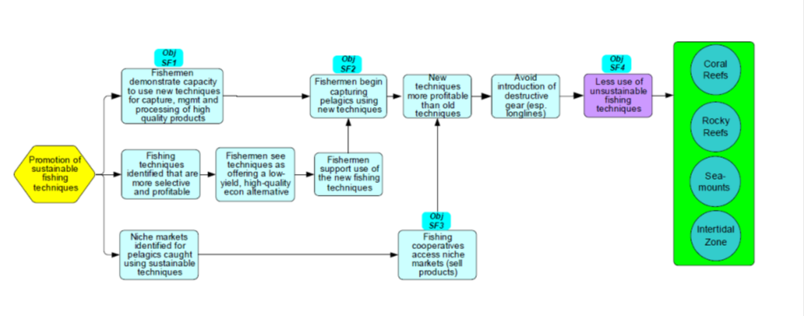
Theory of Change
(more intermediate steps in the chain)
Notes:
The key idea here is that this approach allows all of the meaningful and critical stages in a change process to be documented, rather than abstracted into just a few standardised elements in the log-frame

Slide 6
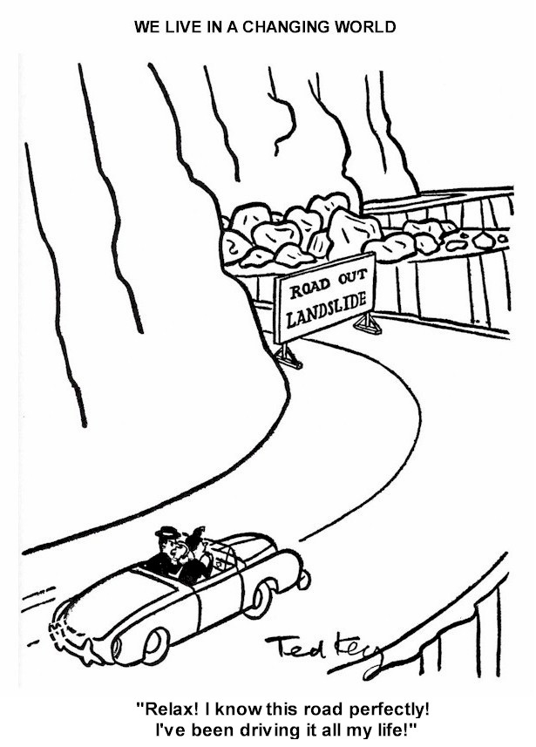
Make explicit the assumptions and context in the theory
What is the real world context
Sequential process of change reaches impact
The project works within a wider context
What are the assumptions about how the change happens, consider dependencies
Are the directions of change uni-directional
What evidence do you have to support your assumed theory

Slide 7
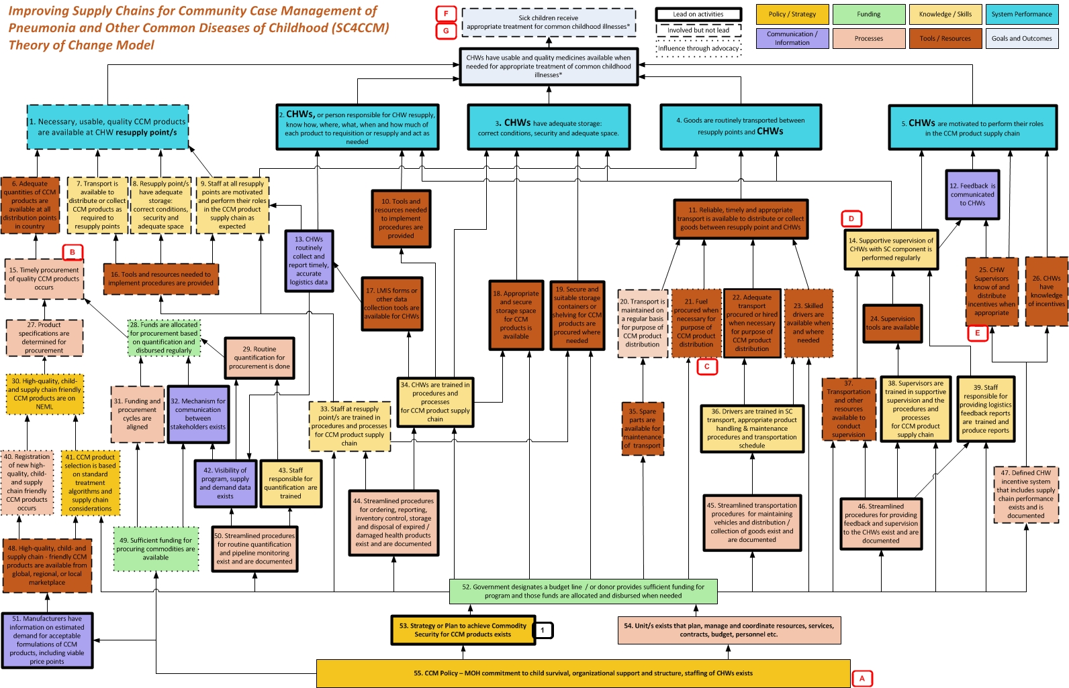

Slide 8
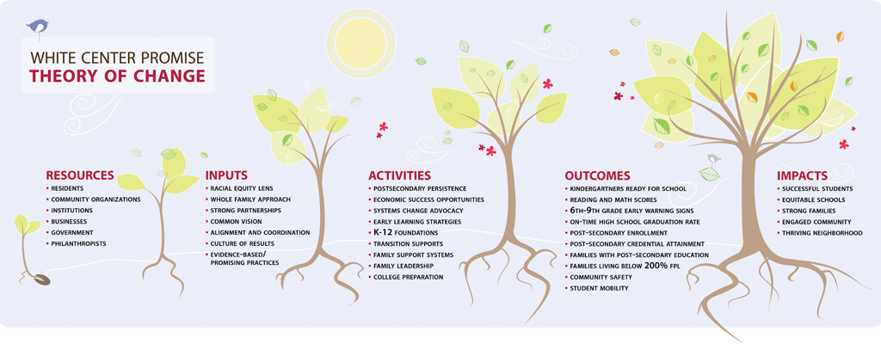

Slide 9
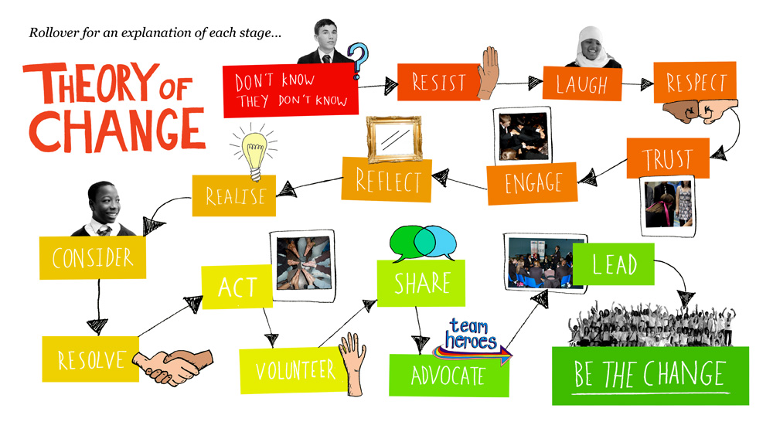

Slide 10
Example – the Darwin ToC

Slide 11
Group Exercise
Review Inputs and Impacts – what goes on in the ‘missing middle’?
Are there other necessary steps – what causes what to move from intervention to outcome?
Are there other necessary steps – what causes what to move from outcome to impact?
Think about the ARROWS what are the critical assumptions that need to be considered -
What are the areas of risk and uncertainty?

