Slide 1



The Darwin Initiative
Communications Opportunities

Slide 2
Resources available to help promote the Darwin Initiative
Communication Channels
Different Audiences
Darwin newsletter
Twitter account
Facebook page
YouTube Channel
Blog
Learning notes
Darwin Community
Government ministers
Peers
General Public
Policy makers
….put yourself in the audiences shoes

Slide 3
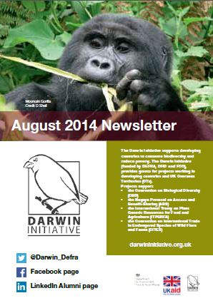
Newsletter
Quarterly
1-2 page articles
Use images to grab attention
Distributed widely via e-mail, Twitter and internally in Defra and DFID

Slide 4

Twitter
@Darwin_Defra
Tweet us your project updates and blogs
#Nature4Life

Slide 5
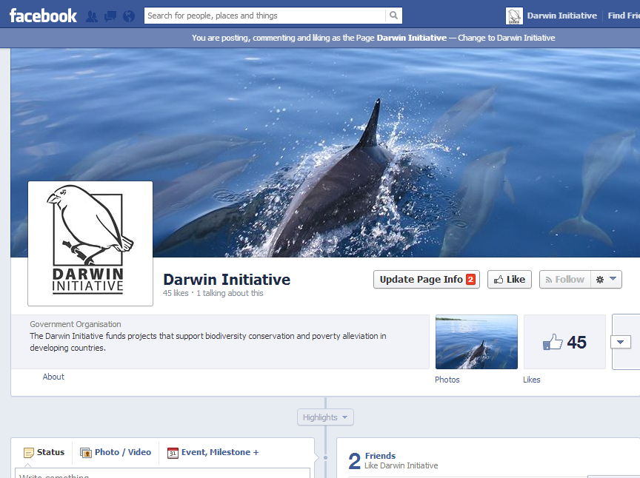
Facebook
Project of the Month
Photo Library (flickr)
YouTube Videos
Updates
Newsletter

Slide 6
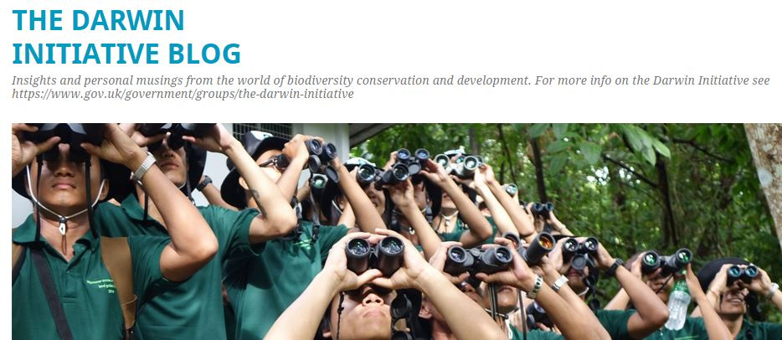
Blog
Biodiversity and Poverty
Monitoring and Evaluation Techniques
Project Communications
All things Darwin

Slide 7
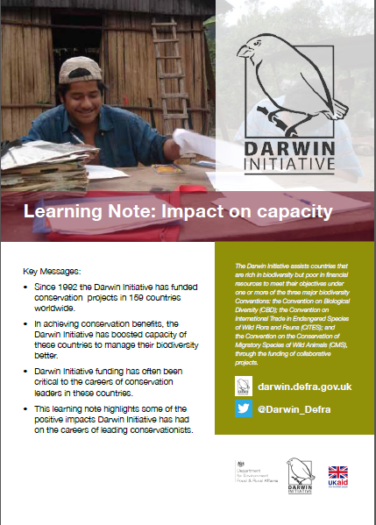
Learning Notes
Used to highlight and promote the Darwin Initiative
For specific events or occasions
Thematic
Heavily reliant on good images and good stories

Slide 8
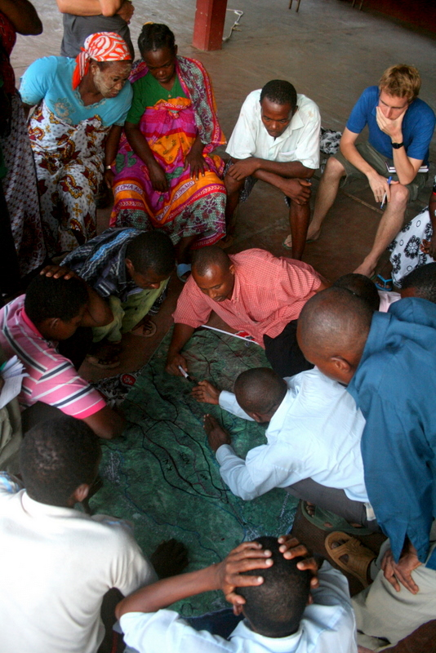
Other Opportunities
CBD Side events
Workshops
Lectures
Conferences
International Campaigns

Slide 9
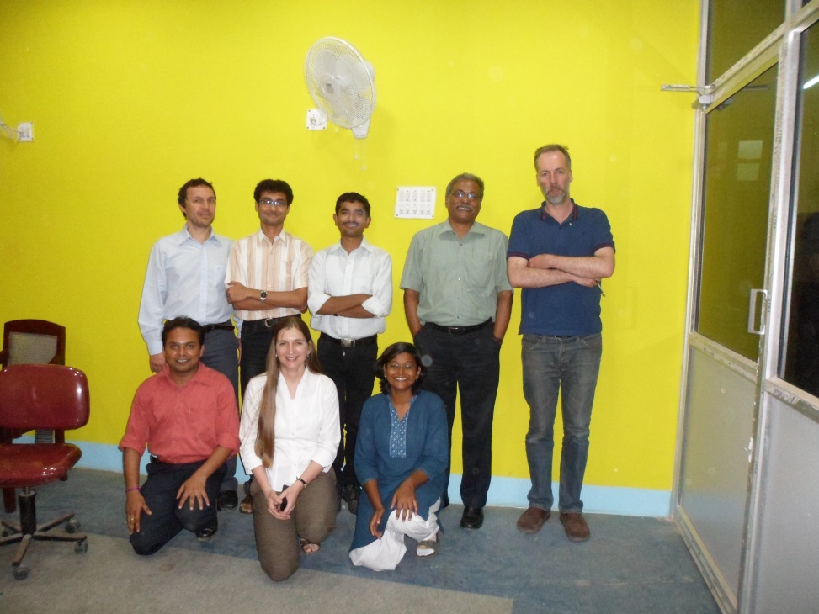
Photos speak louder than words
Great Photo
Less useful photo

Slide 10
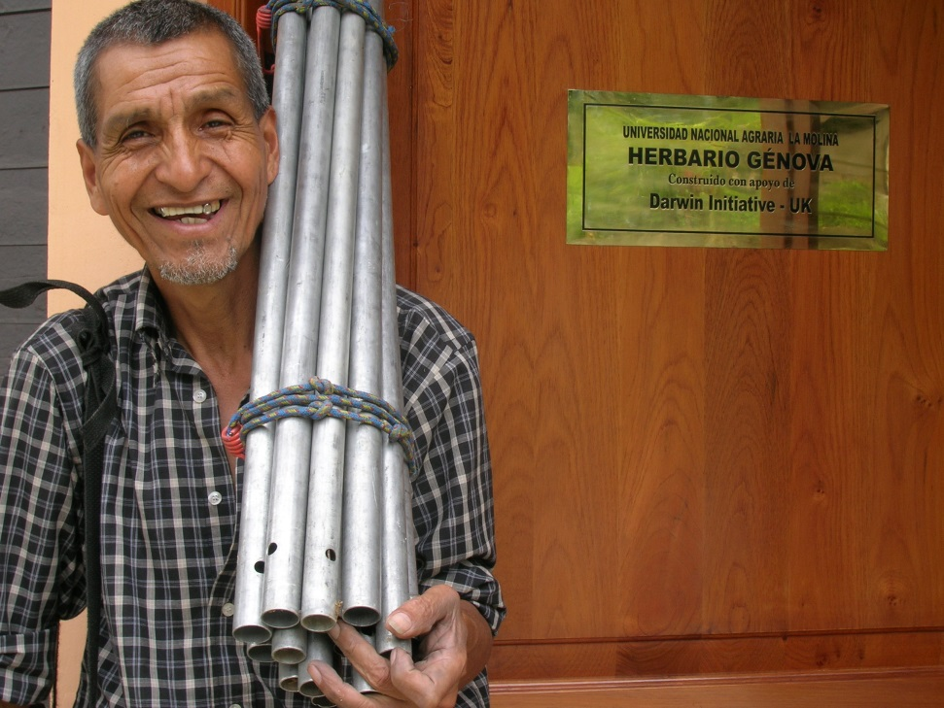
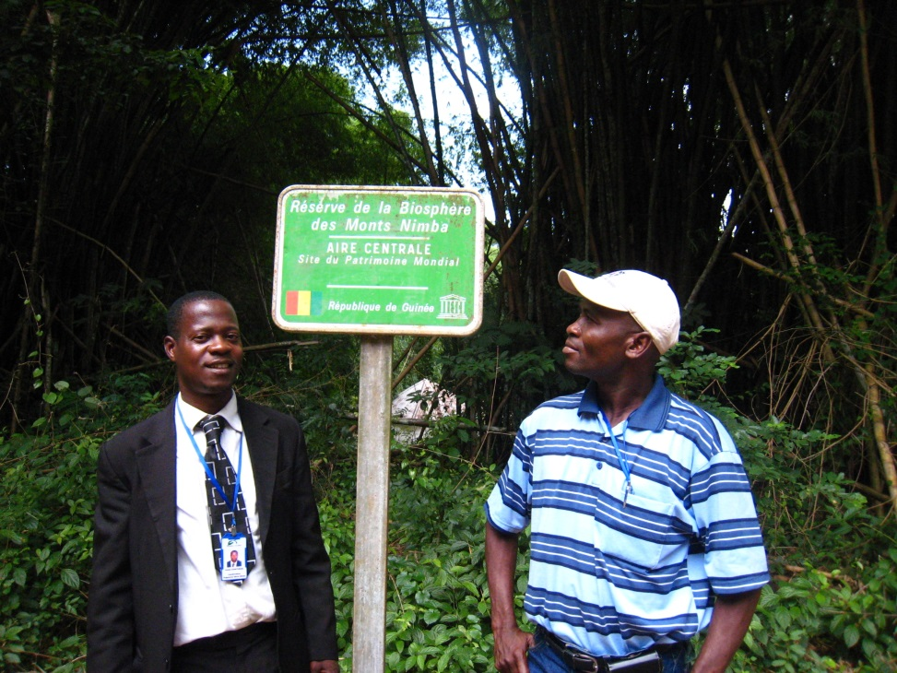
Photos with signs
Can’t read – but he’s happy!
Can’t read but at least he’s looking

Slide 11
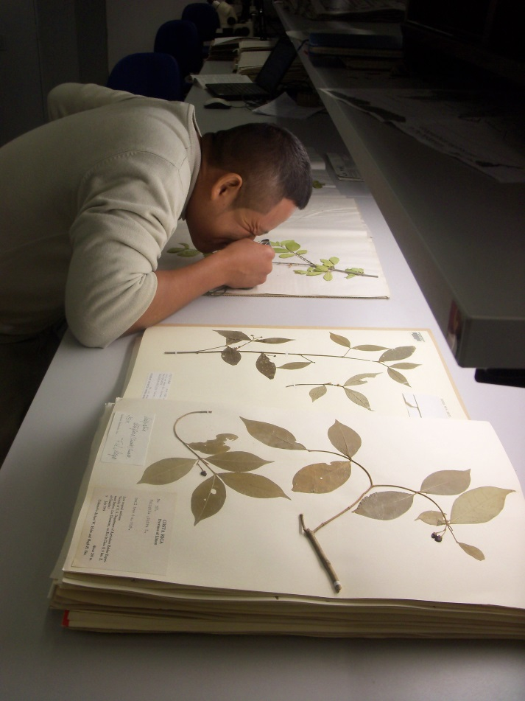
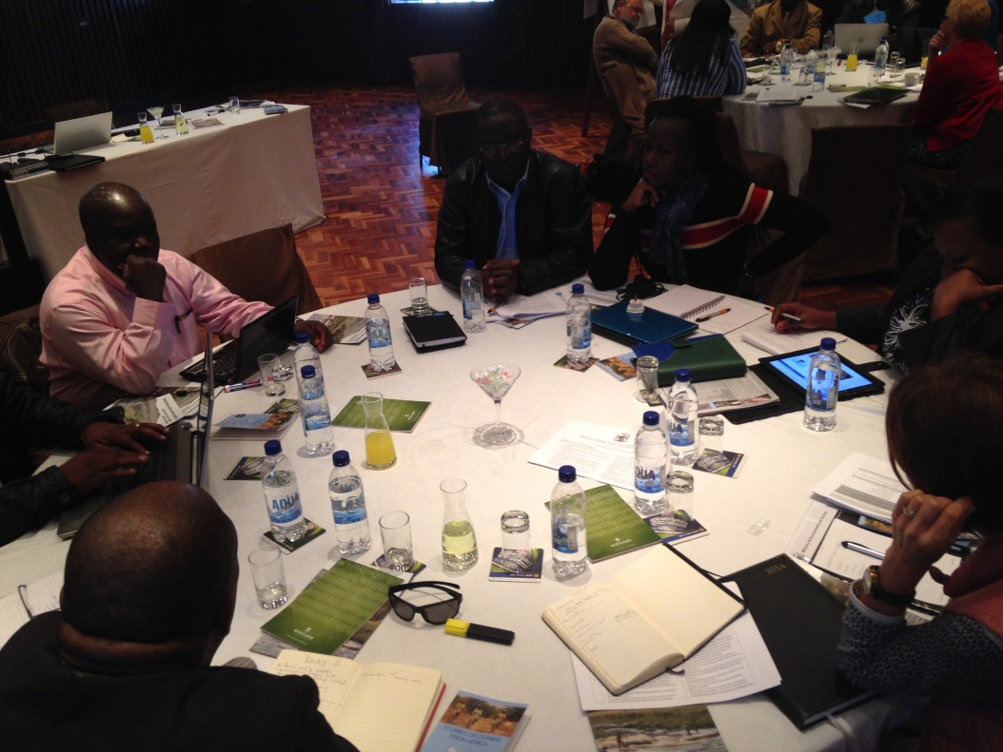
Action Photos
Great photo
Not so great

Slide 12
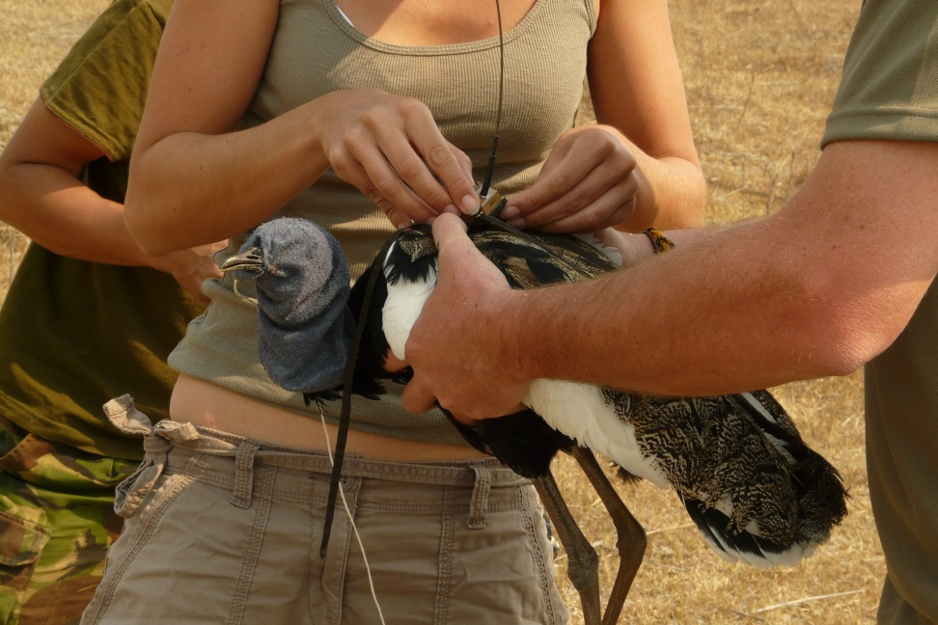
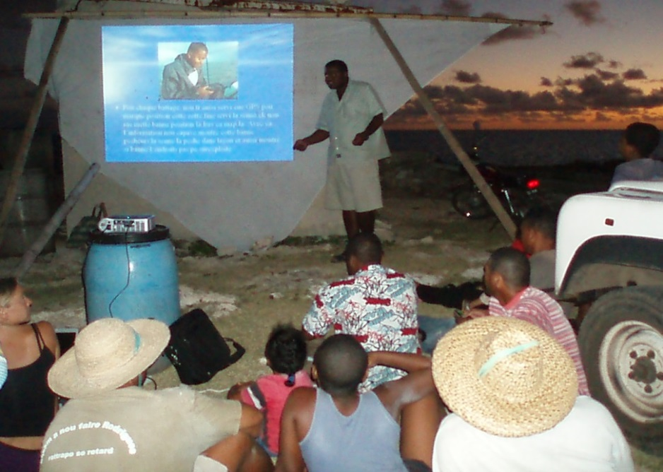
Action Photos

Slide 13
Remember
Reduce your text if possible – keep it simple
Choose photos carefully – does it match the article?
Choose eye-catching photos- rule of 1/3
Captions and credits are important
Consider your audience
Darwin-newsletter@ltsi.co.uk

