Slide 1




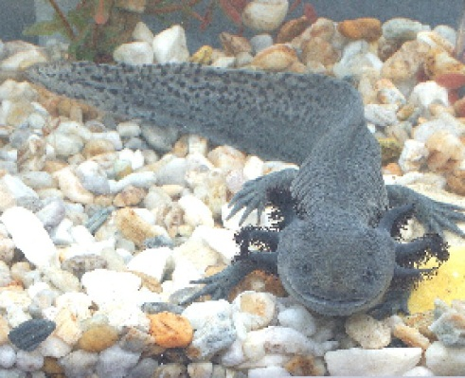
SMART Indicators

Slide 2
S.M.A.R.T.
Specific to the objective it is supposed to measure
Measurable (either quantitatively or qualitatively)
Achievable by the project and available at an acceptable cost
Relevant to the information needs of managers
Time-bound – so we know when we can expect the objective/target to be achieved

Slide 3
D.U.L.L.
Answers on a post card please

Slide 4
In addition
Indicators should be independent of each other
The set should be parsimonious
Indicators should be objectively verifiable.

