Slide 1



Introduction to Darwin Initiative reporting systems
Financial and Technical

Slide 2

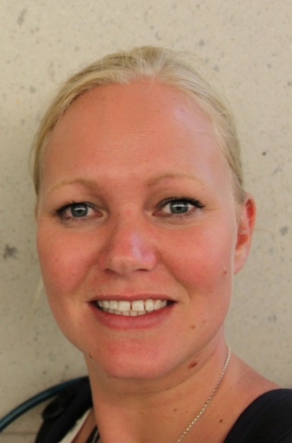
LTS International
Administration and management support to the Darwin Initiative since 2003
Eilidh Young
Darwin-Projects@ltsi.co.uk
Lesley King
Lesley-King@ltsi.co.uk
Day to day contact with all Darwin projects
Supports all projects and acts as clearing-house for most queries.
Technical support to the Darwin Initiative

Slide 3
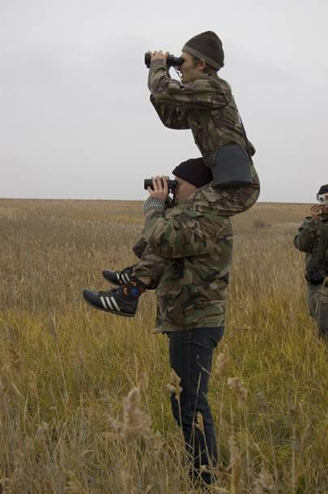
Reporting & Accountability
Projects have a number of requirements in terms of reporting to the DI to ensure the high standard of DI projects is maintained.
These can broadly be divided into:
  Project technical reporting
  Project financial reporting

Slide 4
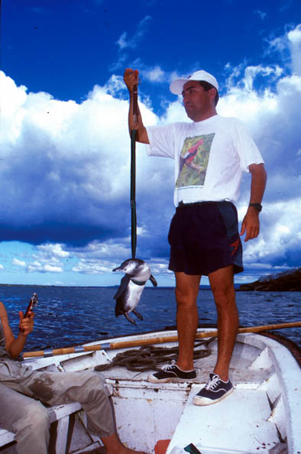
Expectations of a Darwin project
As per the DI criteria
high quality and scientific;
collaborative;
assist to meet their objectives under CBD, Nagoya, ITPGRFA & CITES.
should address poverty alleviation*

Slide 5
Project Reporting (Technical)
Projects required to report twice per year for the duration of their grant:
  Half Year reports
  Annual Reports
  Final
Project reports are posted on the website (minus contact details & financial details)
Reminder sent 1 month before deadline
Final report
Annual Report
Half Year Report

Slide 6
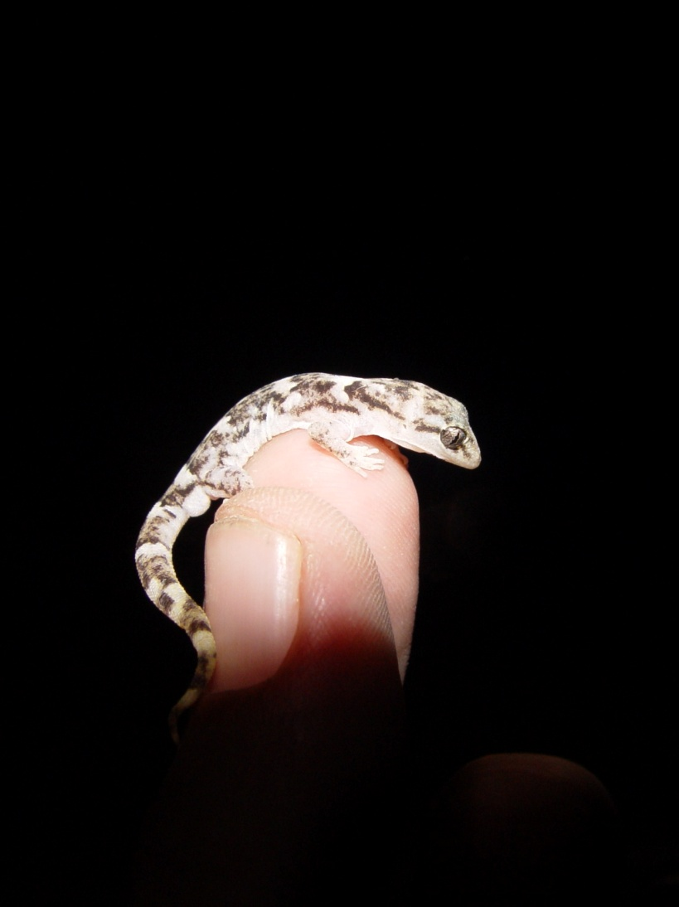
Half Year Reports
Provide a brief update on project progress
Opportunity to discuss queries/issues (available year round however from LTS)
Submitted by 31st October annually

Slide 7
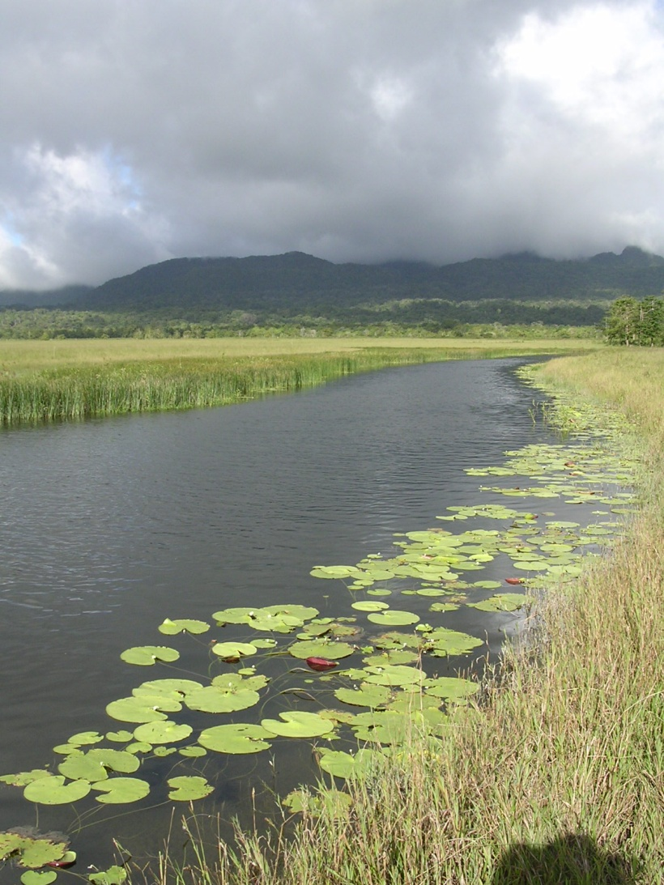
Annual Reports
to detail progress against planned activities, outputs & purpose;
Good use of indicators & evidence (means of verification) reduces reporting burden;
Due 30th April annually;

Slide 8
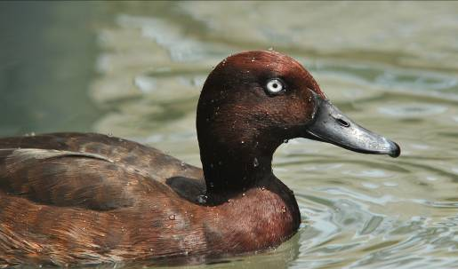
Final Reports
Provide information on the overall success of the project against its proposed purpose, outputs and activities
Good use of indicators and evidence (means of verification) reduces reporting burden;

Slide 9

Financial Reporting Requirements
Quarterly advance claims;
An audit at closure of project;
Defra retain the right to spot check;

Slide 10
Quarterly Advance Claims
  Quarters 1, 2 are advance claims linked to reporting and return of Annual Grant Acceptance Form
  Quarter 3 is a straight advance
  Quarter 4 Actual Claim is not an advance and is dependent on actual expenditure for the year
  A retention is made from the final claim pending a satisfactory final report.

Slide 11
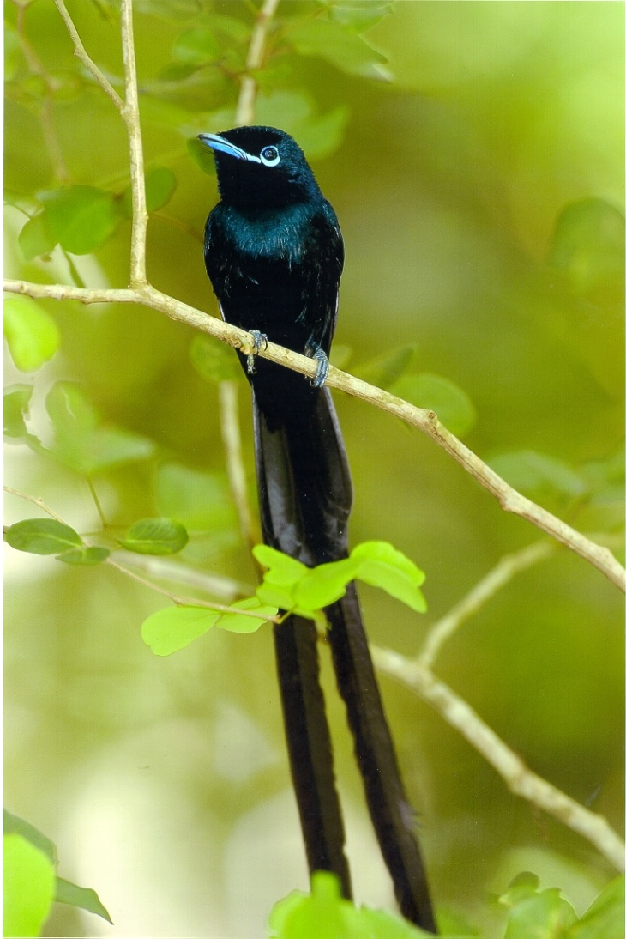
Claim Process
Hard copy with wet signature;
LTS checks claim total and that related reporting received;
Batched eligible claims to Defra for approval
Agreed claims then sent for payment
You will be informed when to expect payment to your account

Slide 12
Conditions for Payment
Claim | Reporting | Financial | Other
Quarter 1 – advance | n/a | n/a | Year 1 – signed Award Acceptance Form received From Year 2 onwards, signed Annual Grant Acceptance Form received
Quarter 2 – advance | From Year 2 onwards, prior year annual report received. | From Year 2 onwards, prior year Quarter 4 – actual claim received and verified. | n/a
Quarter 3 – advance | From Year 2, prior year annual report accepted as administratively complete | n/a | n/a
Quarter 4 – actual | Annual report received | Quarter 4 – actual claim received and verified. | n/a
Final claim, less retention | Final report | Final claim form | n/a
Retention | Final report accepted | Audit letter - where required | n/a

Slide 13
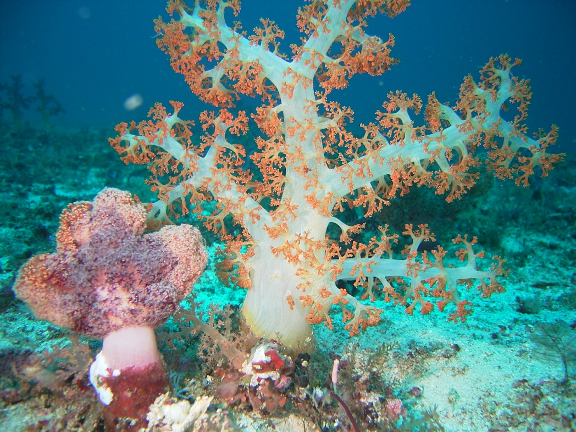
Change Requests
All projects looking to make significant changes (both technical and financial) should submit a change request form*.
This includes:
  Virements
  Carry forwards
  Changes to logical framework
  Staff changes (senior technical staff) including CV
  Timing changes (e.g. extensions)
*Change request forms can be found on the website

Slide 14
Reducing the reporting burden
Handy tips

Slide 15
Annual reports
Report against original application unless changes have been made to logframe
Significant changes to Logframe/design need to be approved (change request forms on the website)

Slide 16
Indicators
Indicators are what will be measured to show progress and outcome
Should be SMART:
S = Specific
M = Measurable
A = Achievable
R = Relevant
T = Time bound

Slide 17
Means of Verification
Should be submitted in reporting as verification of progress
Reduces onerous narrative reporting
IN-REPORT
Use of secondary data
Illustrative quotes – table
Figures
ADDITIONAL DOCS
Meeting minutes of Steering Committee approving plans
Letter formally accepting management plans from Ministry of Environment
Photos

Slide 18
Reporting Evidence – Don’ts
Write general statements without evidence, for example:
“we are making good progress”
“we believe this is true”
“we think that this progress is adequate”
Only list activity outputs
(no. of workshops, plans, maps etc)
No evidence = unsubstantiated claims
Forget about higher level outcomes and impacts – what has changed and how in terms of biodiversity and poverty?

Slide 19
Reporting Evidence – Do’s
Provide evidence (graphs, tables, photos, quotes)
Demonstrate where claims come from, for example:
“We are making good progress towards our goal, as demonstrated by data provided in table x”
“From interviews with local residents about ….., we believe this to be true [insert quote as evidence]”
Move beyond reporting on outputs - include evidence on what has changed
“The workshop provided X community members with knowledge about sustainable pest management. Evidence from a follow-up survey indicated that chemical pesticide use has declined by 50%, which is expected to have positive impacts in local biodiversity (FAO, 2013). Crop yields for previously affected crops have increased by between 10-30%; thus demonstrating a contribution to poverty alleviation.

Slide 20
Reporting on indicators
Indicator | Frequency | Baseline | End of Year 1 | End of Year 2 | End of Year 3 | Target | Data Source / MoV
No. of citings of lesser spotted Dingo | Per visit | 10 | 6 | 5 | no data | 1 | Field visits
No. of micro-credit transactions | Per annum | 20 | 40 | 60 | no data | 60 | Field reports/surveys
Number of hunting incidents | Per annum | 200 | 150 | 100 | no data | 20 | Official park reports
“you can’t buy dingo these days, it is very rare to find it in the market”
(Market Trader, Bulgaria, Focus Group, 2015)

Slide 21
The Elevator pitch

Slide 22
Could you improve how you explain your project?
Simplify the language?
Explain jargon? Remove the jargon?
Highlight what is unique?
Use active tense rather than passive?
Talk more about why it is important rather than what you will be doing?

Slide 23
Your Challenge
Before the break – spend 1-2 minutes jotting down important points on a post-it.
During the break - in pairs or groups of 3:
  Step 1: 10 floors (2 minutes)
  Steph 2: 5 floors (1 minute)
  Step 3: 1 floor – 10 seconds!
After the break – report back to the group on your partners project

