Slide 1



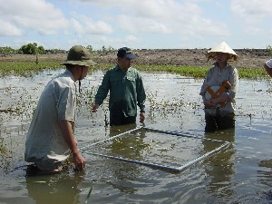

The Darwin Initiative
Setting (& Testing) Objectives

Slide 2
Problem analysis & setting your objectives
The more information & understanding one has about the problem situation, the more specifically one can formulate objectives.
Various Problem Analysis methods: Symptoms vs Causes, Identification of Drivers, Problem Trees, Problem Rivers, etc.
Problem(s) can be transformed into objective(s) by mirror-imaging and restating the negatives as positives

Slide 3
Objectives
The purpose of setting objectives for a project is to define what you are aiming at (the desired future situation), in order that you can then work out a plan of action to achieve and measure the performance of it
During implementation, progress is monitored to determine whether the project is still on track towards achieving its objectives.
2 main types: Overall & Specific
Verbs!
Hierarchy & Logic

Slide 4
‘Overall Objective’/Impact
Higher level Objective of the wider sectoral or national programme, to which the project is designed to contribute (in the longer run) MDG and/or possibly Convention
Your project alone will not be able to solve the problem but it will strive to contribute to the overall goal and to have a long-term impact.
Word/Verb-wise use the infinitive for describing your overall objective: e.g. “to mitigate the negative impact of migration on family members rights in countries of origin”.

Slide 5
Specific Objectives/Outcomes
Should clearly describe the new/changed situation(s) you want to achieve
State what the project should achieve for its intended beneficiaries’
They should be realistically achievable by the end of the funding period or shortly thereafter.
Wording/verbs – again use the infinitive for describing your specific objective(s): “to provide leisure activities and psychological services to the children of migrants in XY”
Nice to dos vs Need to dos

Slide 6
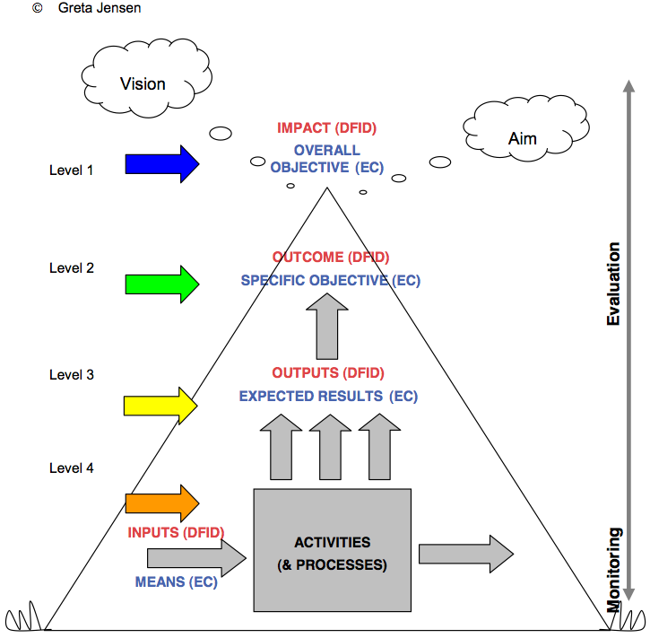

Slide 7
Logframes etc.
In the narrative re ‘Objectives’ (i.e. for DI ‘Impact’ and ‘Outcome’), the Logframe sets out the intervention logic of the project and describes the important assumptions and risks which underlie this logic.
This provides the basis for checking the feasibility of the project, ensuring that improbable assumptions or undue risks are carefully assessed.
Think upwards
Plan downwards

